Slide 1



BTCS2400
Operating System
Unit – 2
Process and Threads Management
Subject Faculty: Prof. Aanchal Phutela
Computer Engineering
aanchal.phutela@gu.edu.in

Slide 2
Disclaimer
It is hereby declared that the production of the said content is meant for non-commercial, scholastic and research purposes only.
We admit that some of the content or the images provided in this channel's videos may be obtained through the routine Google image searches and few of them may be under copyright protection. Such usage is completely inadvertent.
It is quite possible that we overlooked to give full scholarly credit to the Copyright Owners. We believe that the non-commercial, only-for-educational use of the material may allow the video in question fall under fair use of such content. However we honor the copyright holder's rights and the video shall be deleted from our channel in case of any such claim received by us or reported to us.

Slide 3
Topics to be covered
Concept of Process
Process Relationship , Process states
Process State transitions
Process Control Block
Context switching
Concept of Threads, Thread Scheduling
Types of Schedulers, Scheduling criteria
CPU Scheduling algorithms : FCFS, SJF, RR and Priority
Types of Scheduling: Preemptive and Non- preemptive

Slide 4
Concept of Process
Process can be define in various ways:
An instance of program running on a computer.
The entity that can be assigned and execute on a processor.
Program in execution.

Slide 5
Concept of Process
Program is passive entity stored on disk (executable file), process is active
Program becomes process when executable file loaded into memory.
Daemons: processes that are running in the background mode (e.g..checking email)

Slide 6
Two State Process Model
Process operations: (two state process model)
Process creation
Process terminations

Slide 7
Process operations- process creation
System initialization:
When OS is booted, several system process are created. They provide system services. They do not need user interaction it just execute in background.
Execution of a process creation system call:
A running process can issue system call to create new process. i.e. in Unix system call name “fork” is used to create new process.

Slide 8
Process operations- process creation
A user request to create a new process
User can start new process by typing command or double click on some application icon.
Initiation of a batch job:
This applies only to the batch system. Here user submit batch jobs to the system. When there are enough resources are free to execute a next job a new job is selected from batch queue.

Slide 9
Process operations- process termination
Normal exit (voluntary)
Terminate when done their job. i.e. when all the instructions from program get executed.
Event user can select option to terminate the process.
Error exit (voluntary):
Process even terminated when some error occurred. Example divide by zero error.

Slide 10
Process operations- process termination
Fatal error (involuntary):
Fatal error are generated due to user mistake in executing program. Such as file name not found error.
Killed by another process (involuntary):
If some other process request for OS to kill the process. Then UNIX it can be done by “kill” system call while in windows “Terminate Process”

Slide 11
Process Relationship
One to one:
when single execution of sequential program is in progress.
Program consist of main program and set of functions, during execution control flows between main program and set of functions.
OS is not aware of the existence of function. So program consist of single process.
Many to one:
Many simultaneous executions of program.
Program informs OS about its parts that are to be executed concurrently thus OS consider each part as process.
So one program any many process.
This process are know as concurrent process.

Slide 12
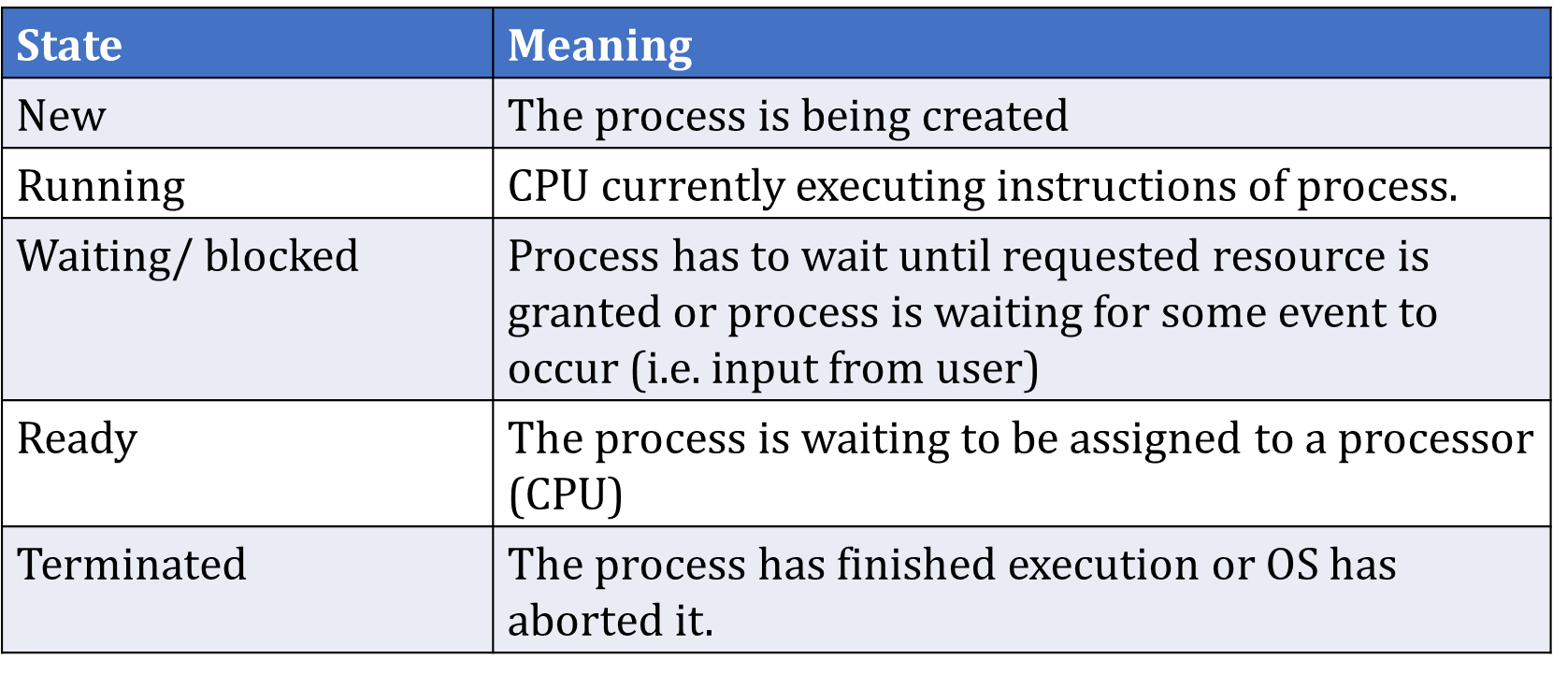
Process States
Process state is an indicator of the nature of current activity in process.

Slide 13
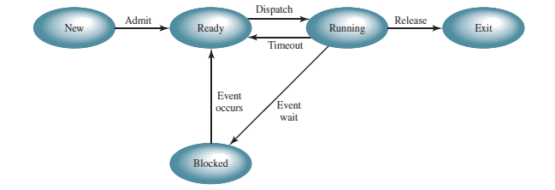
Process State Transitions
A state transitions for process p is change in its state.
Five state process model:

Slide 14
Process State Transitions
State Transition | Description
Ready → Running | CPU start or resumes its execution
Blocked → Ready | Request made by process is satisfied or event for which process was waiting occurs.
Running →Blocked | Process request for I/O Request for memory or some other resources. Waits for message from other process.

Slide 15
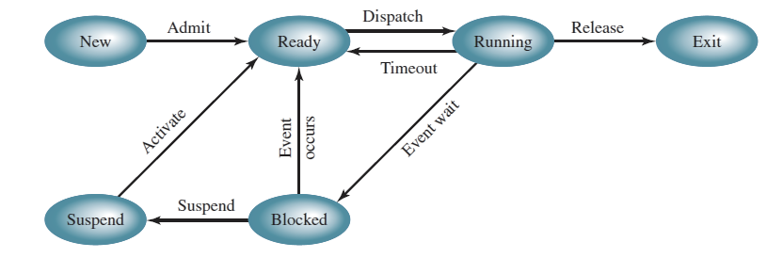
Process State Transitions

Slide 16
Process State transitions
Reason for suspension of process:
Swapping: moving process from memory to disk.
Other OS reasons: OS may suspend process that is suspected of causing problem.
Interactive user request: a user may wish to suspend execution of program for debugging.
Timing: time out.
Parent process request: parent process may suspend execution of child process.

Slide 17
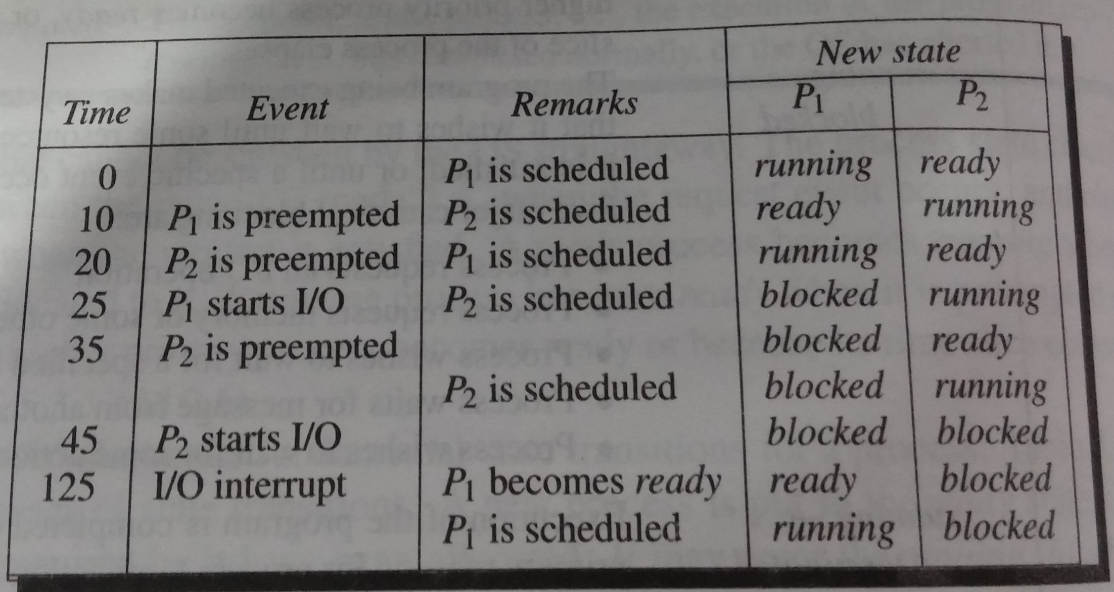

Slide 18
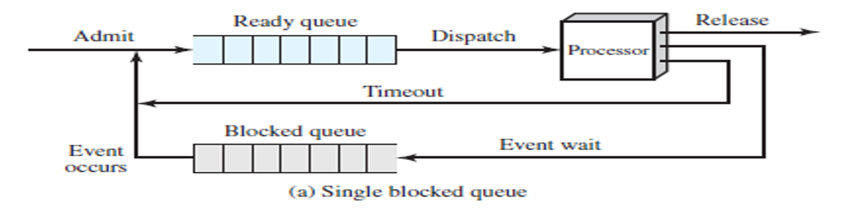
Queue Diagram
For single Waiting Queue

Slide 19
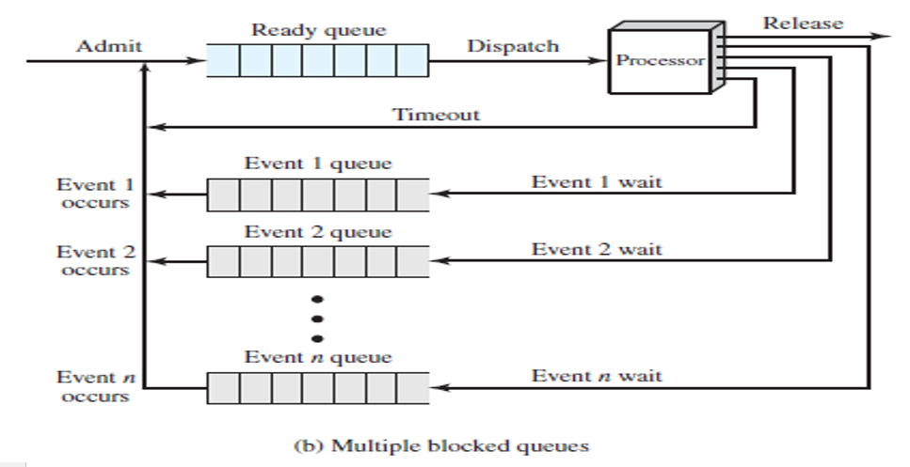
Queue Diagram
For multiple waiting Queue

Slide 20
Process Control Block (PCB)
To implement the process model, the operating system maintains a table called the process table.
Process table is array of structure
Another name for process table is process control block (PCB)
PCB is the key to multiprogramming.
PCB must be saved when a process is switched from running to ready or blocked states.

Slide 21
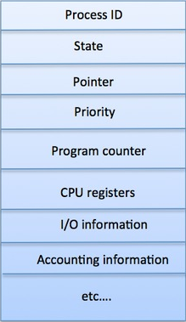
PCB Fields
Process ID - Unique identification for each of the process in the operating system.
Process State - The current state of the process i.e., whether it is ready, running, waiting.
Pointer - A pointer to parent process.
Priority - Priority of a process, its typically numeric value. A process is assigned a priority at its creation.
Program Counter - Program Counter is a pointer to the address of the next instruction to be executed for this process.

Slide 22
PCB Fields
CPU registers – contains the content of the register when the CPU was last released by the process.
IO status information - This includes a list of I/O devices allocated to the process.
CPU scheduling information - it includes process priority, pointer to various scheduling queue, information about events on which process is waiting and other parameters.

Slide 23
PCB Fields
Program Status Word (PSW) - this is snapshot i.e. the image of the PSW when the CPU was last voluntarily leave by the process.
Memory management information - it includes values of base and limit registers, information about page table or segment table.
Event Information - for a process in the blocked state, this field contains information about event for which the process is waiting, when an event occurs kernel uses this information.

Slide 24
Context Switching
This needed when multiple processes to share a single CPU.
context is information stored in PCB.(e.g. program counter and other registers).
a context switch is the process of storing and restoring the information of a process so that execution can be resumed from the same point at a later time.

Slide 25
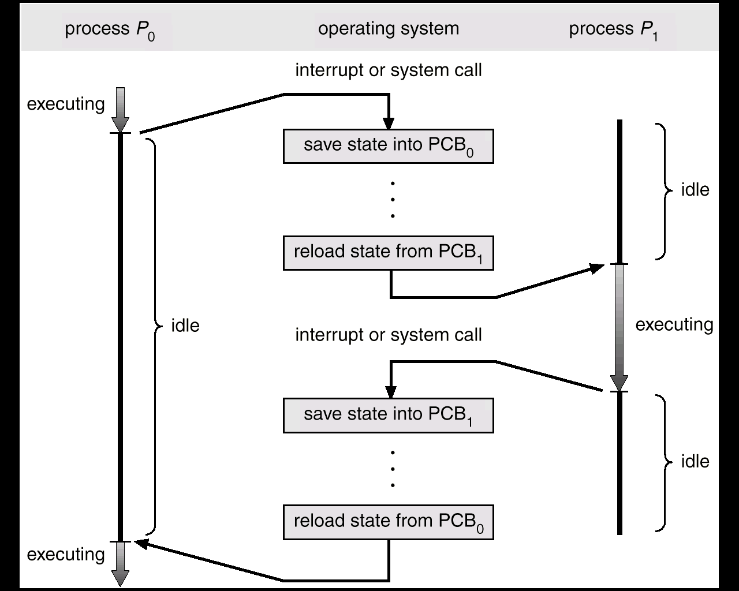
Context Switching

Slide 26
Process Scheduling
CPU scheduling is the basis of multiprogramming operating systems.
By switching the CPU among processes, the operating system can make the computer more productive.
The aim of CPU scheduling is to assign processes to the processor.
Selects processes that are ready to execute, and allocates the CPU to one of them.

Slide 27
Process Scheduling
Need
Switches from running to waiting state
Switches from running to ready state
Switches from waiting to ready
Terminates

Slide 28
Types of Scheduler
Long term scheduler
When process is created.
selects process and loads it into ready queue (memory) for execution.
This is a decision whether to add a new process to the set of processes that are currently active.
Medium term scheduler
Memory manager.
Swap in, Swap out from main memory non-active processes.

Slide 29
Types of schedulers
Long Term
Scheduler
Short Term
Scheduler
Ready Queue
Dispatch
Exit
Admit
Processor
Time-out
Medium Term
Scheduler
Event Wait
Event
Occurs
Blocked Queue

Slide 30
Types of Scheduler
Short term scheduler
Deals with processes among ready processes.
Very fast, similar to action at every clock interrupt
if a process requires a resource (or input) that it does not have, it is removed from the ready list (and enters the WAITING state).
Short-term scheduling is the actual decision of which ready process to execute next

Slide 31
CPU Scheduling Terminology
Burst Time/Execution Time/Running Time: the time process requires for running on CPU.
Waiting Time: time spend by process in ready state waiting for CPU.
Arrival Time: when a process enters ready state.
Exit Time : when process completes execution and exit from the system.
Turn around Time: the total time spend by the process in the system.
Response Time: the time between a process enters ready state and get scheduled on the CPU for the first time.

Slide 32
CPU Scheduling Criteria
CPU utilization
keep the CPU as busy as possible
Throughput
number of processes that complete their execution per time unit
Turnaround time
amount of time to execute a particular process, that is the interval from the time of submission of a process to the time of completion is the turnaround time.
TAT= Exit Time – Arrival Time OR
TAT= Burst time+ Waiting Time

Slide 33
CPU Scheduling Criteria
Waiting time
amount of time a process has been waiting in the ready queue.
Response time
time from the submission of a request until the first response is produced or amount of time it takes from when a request was submitted until the first response is produced.
WT= TAT- Burst Time

Slide 34
Scheduling Algorithm Objectives
Maximum CPU utilization
Maximum throughput
Minimum turnaround time
Minimum waiting time
Minimum response time

Slide 35
CPU Scheduling - Non Pre-emptive
Non Pre-emptive:
Under non preemptive scheduling, once the CPU has been allocated to a process, the process keeps the CPU until it releases the CPU either by terminating or by switching to the waiting state.

Slide 36
CPU Scheduling - Non Pre-emptive
Once a process has been given the CPU can taken away due to higher priority process arrived or time out.
Pre-emptive:

Slide 37
Scheduling algorithms
First Come First Served (FCFS)
Shortest Job First (SJF)
Shortest Remaining Time Next (SRTN)
Round Robin (RR)
Priority

Slide 38
First Come First Served (FCFS)
Selection criteria
The process that request first is served first.
It means that processes are served in the exact order of their arrival.
Implementation:
Non preemptive: Once a process is selected, it runs until it is blocked for an I/O or some other event or it is terminated.
Always Non-Pre-emptive in nature.
This strategy can be easily implemented by using FIFO (First In First Out) queue.
When CPU becomes free, a process from the first position in a queue is selected to run.
Head
P1
P2
P3
Tail

Slide 39
First Come First Served (FCFS)
Example
Gantt Chart
Process | Arrival Time (T0) | Time required for completion (∆T) (CPU Burst Time)
P0 | 0 | 10
P1 | 1 | 6
P2 | 3 | 2
P3 | 5 | 4
P0
P1
P2
P3
0
10
16
18
22

Slide 40
First Come First Served (FCFS)
Example
Gantt Chart
Average Turnaround Time: (10+15+15+17)/4 = 14.25 ms.
Average Waiting Time: (0+9+13+13)/4 = 8.75 ms.
Process | Arrival Time (T0) | Burst Time (∆T) | Finish Time (T1) | Turnaround Time (TAT = T1-T0) | Waiting Time (WT = TAT-∆T)
P0 | 0 | 10 | 10 | 10 | 0
P1 | 1 | 6 | 16 | 15 | 9
P2 | 3 | 2 | 18 | 15 | 13
P3 | 5 | 4 | 22 | 17 | 13
P0
P1
P2
P3
0
10
16
18
22

Slide 41
First Come First Served (FCFS)
Advantages
Simple and fair.
Easy to understand and implement.
Every process will get a chance to run, so starvation doesn't occur.
Disadvantages
Not efficient because average waiting time is too high.
Convoy effect is possible. All small I/O bound processes wait for one big CPU bound process to acquire CPU.
CPU utilization may be less efficient especially when a CPU bound process is running with many I/O bound processes.

Slide 42
FCFS Numerical
Question - Find the average TAT and WT for the given processes by using FCFS scheduling algorithm.
Process | Arrival time(AT) | Burst Time (BT)
P1 | 0 | 24
P2 | 0 | 3
P3 | 0 | 3
Process | Arrival time(AT) | Burst Time (BT)
P1 | 0 | 1
P2 | 1 | 100
P3 | 2 | 1
P4 | 3 | 100

Slide 43
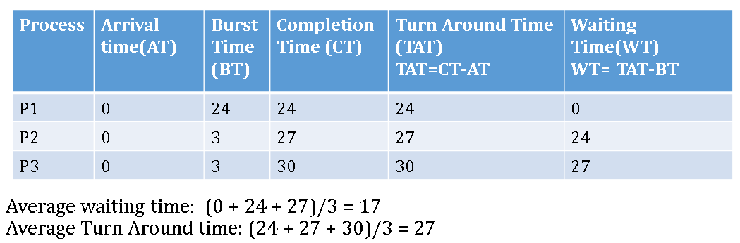
Solution-1

Slide 44
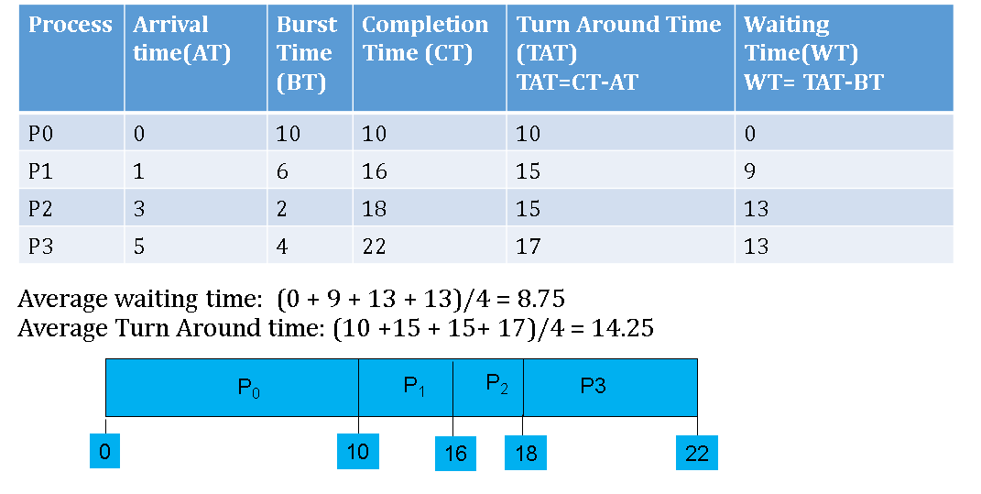
Solution-2

Slide 45
Shortest Job First (SJF)
Selection criteria
The process, that requires shortest time to complete execution, is served first.
Decision Mode
Non preemptive: Once a process is selected, it runs until either it is blocked for an I/O or some other event or it is terminated.
Implementation:
This strategy can be easily implemented by using FIFO (First In First Out) queue.
All processes in a queue are sorted in ascending order based on their required CPU bursts.
When CPU becomes free, a process from the first position in a queue is selected to run.

Slide 46
Shortest Job First (SJF)
Example
Gantt Chart
Process | Arrival Time (T0) | Time required for completion (∆T) (CPU Burst Time)
P0 | 0 | 10
P1 | 1 | 6
P2 | 3 | 2
P3 | 5 | 4
P0
P2
P3
P1
0
10
12
16
22

Slide 47
Shortest Job First (SJF)
Gantt Chart
Average Turnaround Time: (10+21+9+11)/4 = 12.75 ms.
Average Waiting Time: (0+15+7+7)/4 = 7.25 ms.
Process | Arrival Time (T0) | Burst Time (∆T) | Finish Time (T1) | Turnaround Time (TAT = T1-T0) | Waiting Time (WT = TAT-∆T)
P0 | 0 | 10 | 10 | 10 | 0
P1 | 1 | 6 | 22 | 21 | 15
P2 | 3 | 2 | 12 | 9 | 7
P3 | 5 | 4 | 16 | 11 | 7
P0
P2
P3
P1
0
10
12
16
22

Slide 48
Shortest Job First (SJF)
Advantages:
Less waiting time.
Good response for short processes.
Disadvantages :
It is difficult to estimate time required to complete execution.
Starvation is possible for long process. Long process may wait forever.

Slide 49
Shortest Remaining Time Next (SRTN)
Selection criteria :
The process, whose remaining run time is shortest, is served first. This is a preemptive version of SJF scheduling.
Decision Mode:
Preemptive: When a new process arrives, its total time is compared to the current process remaining run time.
If the new process needs less time to finish than the current process, the current process is suspended and the new job is started.
Implementation :
This strategy can also be implemented by using sorted FIFO queue.
All processes in a queue are sorted in ascending order on their remaining run time.
When CPU becomes free, a process from the first position in a queue is selected to run.

Slide 50
Shortest Remaining Time Next (SRTN)
Example
Gantt Chart
Process | Arrival Time (T0) | Time required for completion (∆T) (CPU Burst Time)
P0 | 0 | 10
P1 | 1 | 6
P2 | 3 | 2
P3 | 5 | 4
P0
P1
P2
P1
P3
P0
0
1
3
5
9
13
22
Process | Remaining Time
P1 | 6
P0 | 9
Process | Remaining Time
P0 | 9
P1 | 4
P3 | 4
Process | Remaining Time
P0 | 9
P2 | 2
P1 | 4
Process | Remaining Time
P0 | 9
P3 | 4
Process | Remaining Time
P0 | 9

Slide 51
Shortest Remaining Time Next (SRTN)
Gantt Chart
Average Turnaround Time: (22+8+2+8) / 4 = 10 ms.
Average Waiting Time: (12+2+0+4)/4 = 4.5 ms.
Process | Arrival Time (T0) | Burst Time (∆T) | Finish Time (T1) | Turnaround Time (TAT = T1-T0) | Waiting Time (WT = TAT-∆T)
P0 | 0 | 10 | 22 | 22 | 12
P1 | 1 | 6 | 9 | 8 | 2
P2 | 3 | 2 | 5 | 2 | 0
P3 | 5 | 4 | 13 | 8 | 4
P0
P1
P2
P1
P3
P0
0
1
3
5
9
13
22

Slide 52
Shortest Remaining Time Next (SRTN)
Advantages :
Less waiting time.
Quite good response for short processes.
Disadvantages :
Again it is difficult to estimate remaining time necessary to complete execution.
Starvation is possible for long process. Long process may wait forever.
Context switch overhead is there.

Slide 53
Round Robin (RR)
Each process gets a small unit of CPU time (time quantum), usually 10-100 milliseconds. After this time has elapsed, the process is preempted and added to the end of the ready queue.
Performance
Time quantum q is large ⇒ FIFO
q small ⇒ q must be large with respect to context switch, otherwise overhead is too high.

Slide 54
Round Robin (RR)
Selection Criteria
Each selected process is assigned a time interval, called time quantum or time slice.
Process is allowed to run only for this time interval.
Here, two things are possible:
First, process is either blocked or terminated before the quantum has elapsed. In this case the CPU switching is done and another process is scheduled to run.
Second, process needs CPU burst longer than time quantum. In this case, process is running at the end of the time quantum.
Now, it will be preempted and moved to the end of the queue.
CPU will be allocated to another process.
Here, length of time quantum is critical to determine.

Slide 55
Round Robin (RR)
Decision Mode:
Preemptive: When quantum time is over or process completes its execution (which ever is earlier), it starts new job.
Selection of new job is as per FCFS scheduling algorithm
Implementation :
This strategy can be implemented by using circular FIFO queue.
If any process comes, or process releases CPU, or process is preempted. It is moved to the end of the queue.
When CPU becomes free, a process from the first position in a queue is selected to run.

Slide 56
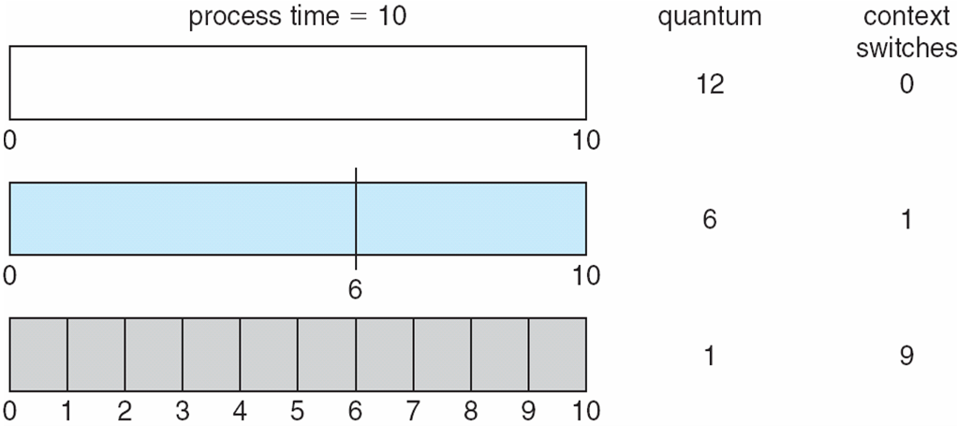
Time Quantum and Context Switch Time

Slide 57
Example of RR with TQ = 4
Process Burst Time
P₁ 24
P₂ 3
P₃ 3
The Gantt chart is: Avg. TAT=15.66
Av WT=5.66
Typically, higher average turnaround than SJF, but better response
P₁
P₂
P₃
P₁
P₁
P₁
P₁
P₁
0
4
7
10
14
18
22
26
30

Slide 58
Round Robin
Process Arrival Service
Time Time
1 0 8
2 1 4
3 2 9
4 3 5
Round Robin, quantum = 4, no priority-based preemption
P1
P2
P3
P4
P1
P3
P4
P3
0
4
8
12
16
20
24
25
26
Average Turn around time=((20-0)+(8-1)+(26-2)+(25-3))/4=18.25
Average wait = ( (20-8) + (7-4) + (24-9) + (22-5) )/4 =(12+3+15+17)/4= 11.75

Slide 59
Example of RR with TQ = 20
Process Burst Time
P₁ 53
P₂ 17
P₃ 68
P₄ 24
The Gantt chart is: Typically, higher average turnaround than SJF, but better response time
Average turn-around time =(134+37+162+121)/4=113.5
Average waiting time=((134-53)+(37-17)+(162-68)+(121-24))/4=(81+20+94+97)=73
P₁
P₂
P₃
P₄
P₁
P₃
P₄
P₁
P₃
P₃
0
20
37
57
77
97
117
121
134
154
162

Slide 60
Round Robin (RR)
Advantages:
Simplest, fairest and most widely used algorithms.
Disadvantages:
Context switch overhead is there.
Determination of time quantum is too critical.
If it is too short, it causes frequent context switches and lowers CPU efficiency.
If it is too long, it causes poor response for short interactive process.

Slide 61
Priority Scheduling
A priority number (integer) is associated with each process
The CPU is allocated to the process with the highest priority (smallest integer = highest priority)
Preemptive
nonpreemptive
Problem =Starvation – low priority processes may never execute Solution =Aging – as time progresses increase the priority of the process

Slide 62
Example-1( Non-preemptive Priority Scheduling)
Process Burst Time Priority
P₁ 10 3
P₂ 1 1
P₃ 2 4
P₄ 1 5
P₅ 5 2
Priority scheduling Gantt Chart
Average turn around time=?
Average waiting time =?
P₂
P₅
P₁
P₃
P₄
0
1
6
16
18
19

Slide 63
Example-1(Non preemptive Priority Scheduling)
Process Burst Time Priority
P₁ 10 3
P₂ 1 1
P₃ 2 4
P₄ 1 5
P₅ 5 2
Priority scheduling Gantt Chart
Average turn around time=16+1+18+19+6=60/5= 12
Average waiting time =(16-10)+(1-1)+(18-2)+(19-1)+(6-5)= 8.2

Slide 64
Example-2
- Non preemptive Priority Scheduling
Suppose that the processes arrive in the order: P₁ , P₂ , P₃
Process | Arrival time(AT) | Burst Time (BT) | Priority
P0 | 0 | 10 | 5
P1 | 1 | 6 | 4
P2 | 3 | 2 | 2
P3 | 5 | 4 | 0

Slide 65
Example-2 : Solution
Suppose that the processes arrive in the order: P₁ , P₂ , P₃ Average waiting time: (0+15+11+5)/4= 7.75
Average Turn Around time: (10+21+13+9)/4 =13.25
Process | Arrival time(AT) | Burst Time (BT) | Priority | Completion Time (CT) | Turn Around Time (TAT) TAT=CT-AT | Waiting Time(WT) WT= TAT-BT
P0 | 0 | 10 | 5 | 10 | 10 | 0
P1 | 1 | 6 | 4 | 22 | 21 | 15
P2 | 3 | 2 | 2 | 16 | 13 | 11
P3 | 5 | 4 | 0 | 14 | 9 | 5
P₀
P₃
P2
P1
0
10
14
16
22

Slide 68
Non Preemptive Priority Scheduling
Advantages:
Priority is considered so critical processes can get even better response time.
Disadvantages:
Starvation is possible for low priority processes. It can be overcome by using technique called ‘Aging’.
Aging: gradually increases the priority of processes that wait in the system for a long time.

Slide 69
Preemptive Priority Scheduling
Now we add the concepts of varying arrival times and preemption to the analysis
Process Arrival Time Burst Time Priority
P₁ 0 8 3
P₂ 1 4 1
P₃ 2 9 5
P₄ 3 5 2

Slide 70
Example of Preemptive Priority Scheduling
Now we add the concepts of varying arrival times and preemption to the analysis
Process Arrival Time Burst Time Priority
P₁ 0 8 3
P₂ 1 4 1
P₃ 2 9 5
P₄ 3 5 2
Preemptive Gantt Chart
Average Turn Around Time=(17-0)+(5-1)+(26-2)+(10-3)=13
Average waiting time = (17-8)+(4-4)+(24-9)+(7-5)=6.5 msec
P₁
P₂
P₄
P₁
P₃
0
1
5
10
17
26

Slide 71
Example-2
Suppose that the processes arrive in the order: P₁ , P₂ , P₃
Process | Arrival time(AT) | Burst Time (BT) | Priority
P0 | 0 | 10 | 5
P1 | 1 | 6 | 4
P2 | 3 | 2 | 2
P3 | 5 | 4 | 0

Slide 72
Example-2 Solution
Process | Arrival time(AT) | Burst Time (BT) | Priority | Completion Time (CT) | Turn Around Time (TAT) TAT=CT-AT | Waiting Time(WT) WT= TAT-BT
P0 | 0 | 10 | 5 | 22 | 22 | 12
P1 | 1 | 6 | 4 | 13 | 12 | 6
P2 | 3 | 2 | 2 | 5 | 2 | 0
P3 | 5 | 4 | 0 | 9 | 4 | 0
Suppose that the processes arrive in the order: P₁ , P₂ , P₃ Average waiting time(12+6+0+0)/4= 4.5 ms
Average Turn Around time: (22+12+2+4)/4 =10 ms
P₀
P1
P2
P3
P1
P0
0
1
3
5
9
13
22

Slide 74
Preemptive Priority Scheduling
Selection criteria :
The process, that has highest priority, is served first.
Decision Mode:
Preemptive: When a new process arrives, its priority is compared with current process priority.
If the new process has higher priority than the current, the current process is suspended and new job is started.
Implementation :
This strategy can be implemented by using sorted FIFO queue.
All processes in a queue are sorted based on priority with highest priority process at front end.
When CPU becomes free, a process from the first position in a queue is selected to run.

Slide 75
Preemptive Priority Scheduling
Advantages:
Priority is considered so critical processes can get even better response time.
Disadvantages:
Starvation is possible for low priority processes. It can be overcome by using technique called ‘Aging’.
Aging: gradually increases the priority of processes that wait in the system for a long time.
Context switch overhead is there.

Slide 76
Do this example for all Algorithms
Process | Arrival Time | Burst Time /Service Time | Priority
A | 0 | 3 | 5
B | 2 | 6 | 3
C | 4 | 4 | 1
D | 6 | 5 | 2
E | 8 | 2 | 4

Slide 77
Do this example for all Algorithms
FCFS TAT | FCFS WT | SJF(non preemptive TAT | SJF WT | SRTF (SJF Preemptive) TAT | SRTF WT | Priority Nonpreemptive TAT | Priority Nonpreemptive WT | Priority Preemptive TAT | Priority Preemptive WT | RR TAT (q=4) | RR WT
3 | 0 | 3 | 0 | 3 | 0 | 3 | 0 | 20 | 17 | 3 | 0
7 | 1 | 7 | 1 | 13 | 7 | 7 | 1 | 15 | 9 | 17 | 11
9 | 5 | 11 | 7 | 4 | 0 | 9 | 5 | 4 | 0 | 7 | 3
12 | 7 | 14 | 9 | 14 | 9 | 10 | 7 | 7 | 2 | 14 | 9
12 | 10 | 3 | 1 | 2 | 0 | 10 | 10 | 11 | 9 | 9 | 7
8.6 | 4.6 | 7.6 | 3.6 | 7.2 | 3.2 | 7.4 | 4.6 | 11.4 | 7.4 | 10 | 6

Slide 78
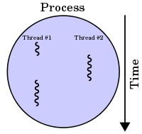
Threads
Definition :-
“A thread is the smallest unit of execution.”
Figure : A process with two threads
of execution on a single processor
machine.
A thread is a light-weight process.

Slide 79
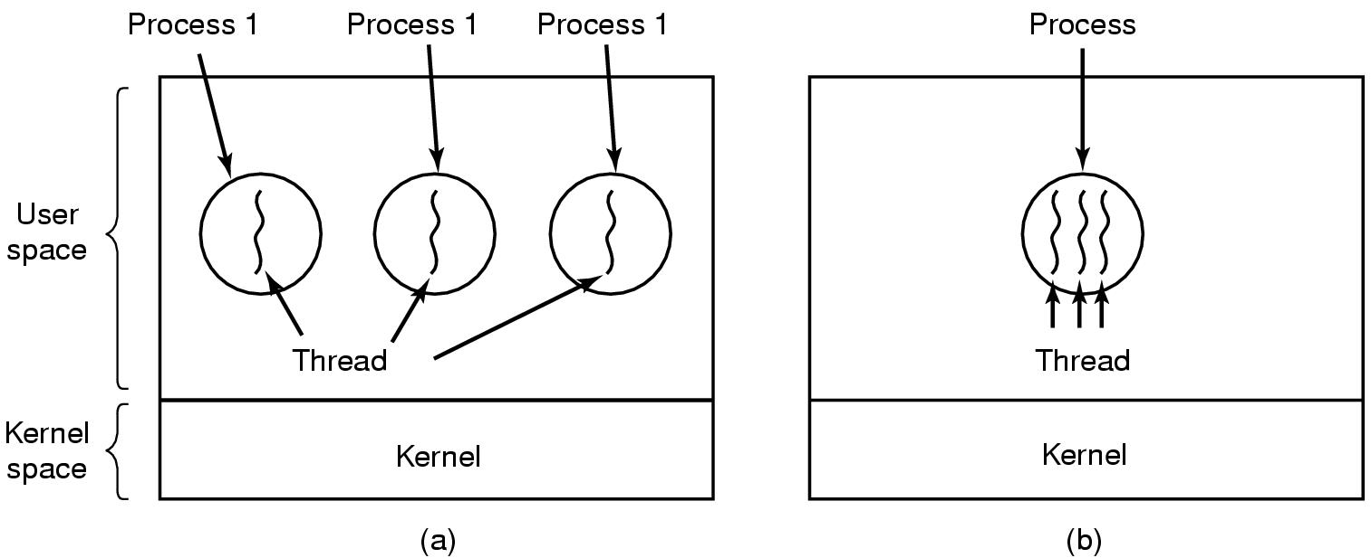
Threads
Threads in three process (a) and one process (b)

Slide 80
Threads vs Processes
Process | Thread
1. System calls involved in process | 1. There is no system call involved
2. OS treats different processes differently | 2. All user level threads treated as single task for OS
3. Different process have different copies of data, files and code | 3. Different threads share same copy of code and data
4. Context Switching is slower | 4. Context Switching is faster
5. Blocking of a process will not block to another process | 5. Blocking a thread will block entire process
6. Independent | 6. Interdependent

Slide 81
Types of Threads
There are two types of threads to be managed in a modern system: User threads and kernel threads.
User threads are supported above the kernel, without kernel support. These are the threads that application programmers would put into their programs.
Kernel threads are supported within the kernel of the OS itself. All modern OS’s support kernel level threads, allowing the kernel to perform multiple simultaneous tasks and/or to service multiple kernel system calls simultaneously.

Slide 82
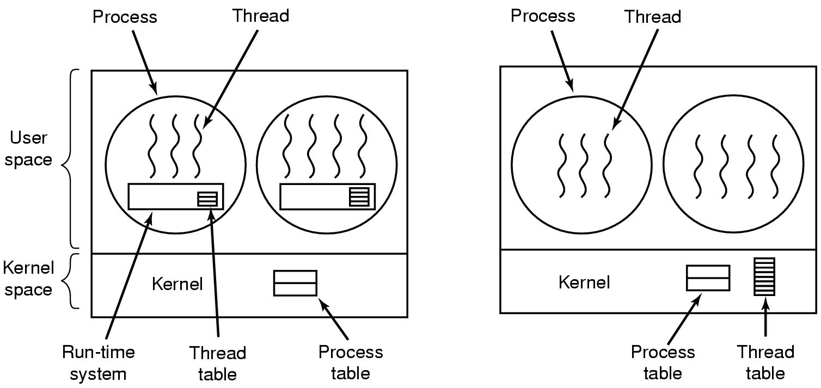
Types of Threads

Slide 83
Threads of User Space
Advantages
Fast switching among threads.
Thread scheduling can be application specific.
Disadvantages
When a user level thread executes a system call, not only that thread but all of the threads within that process are blocked.
Advantages of multiprocessing can not achieve because kernel assigns one process to one processor. ( kernel schedules processes not threads).

Slide 84
Threads of Kernel Space
Advantages
OS is aware of the presence of threads so if one process thread is blocked it can choose next process to run.
OS can schedule multiple threads from the process on multiple processor
Disadvantages
Switching between threads is time consuming because kernel must do the switching.

Slide 85
Multiprocessing vs Multithreading
Multiprocessing is the use of two or more central processing units (CPUs) within a single computer system.
Multi-threading is a widespread programming and execution model that allows multiple threads to exist within the context of a single process.

Slide 86


